Slide 1


Recommender system for suggesting “Frequently used together” SAP Fiori Apps for SAP S/4 HANA system
Jyoti Singh, BA07
Month 06, 2021

Slide 2
Agenda
Background Information
Problem Statement
Proposed Solution
Detailed Scope of Work
Literature Review
Conclusion
Next Steps

Slide 3
Background Information
SAP is a market leader in providing ERP (Enterprise Resource and Planning) solutions and services
In Feb 2015, SAP released their new Solution SAP S/4 HANA. It is a next-generation, intelligent ERP business suite and is the successor of SAP ERP designed specifically for SAP’s in-memory computing SAP HANA database and enhanced User Interface
It is SAP's ERP for large enterprises meant to cover all day-to-day processes of an enterprise (for example, order-to-cash, procure-to-pay, plan-to-product, and request-to-service) and core capabilities
SAP Fiori is a set of apps, that address the most broadly and frequently used SAP functions, such as workflow approvals, information lookups, and self-service tasks etc
They provide simple and easy-to-use user interface across desktops, tablets, and smartphones
SAP Fiori delivers an intuitive, role based UX that improves both employee productivity and satisfaction

Slide 4
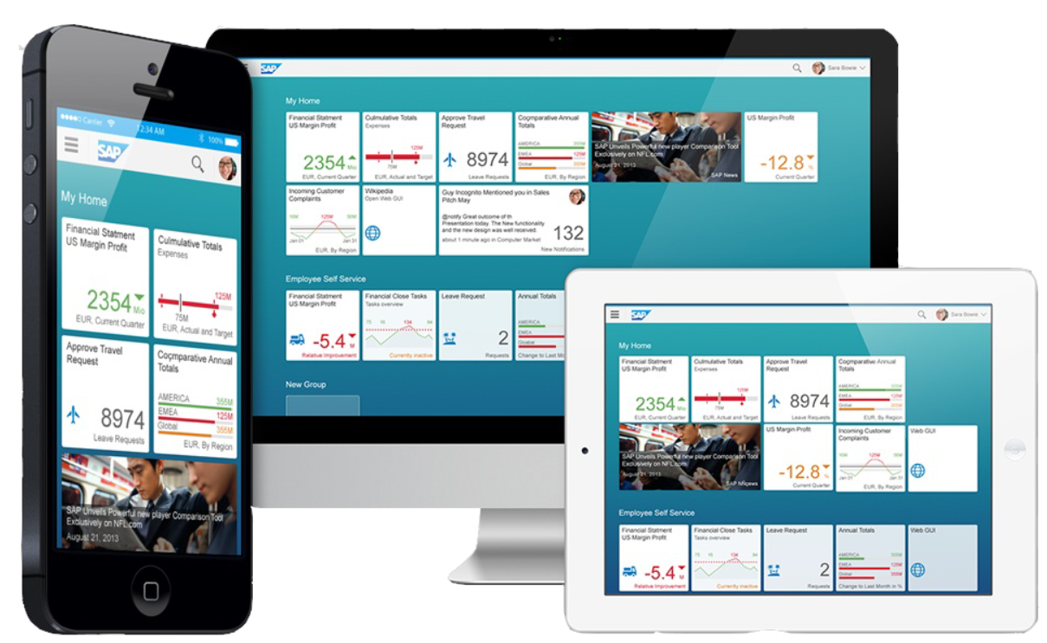
SAP Fiori Apps

Slide 5
Problem Statement
There are hundreds of SAP Fiori Apps in SAP S/4 HANA system, with simplified user interface supporting multiple device types. However, only few of them are getting actively used by Customers, as many of them are ignorant and unfamiliar with the full library of SAP Fiori Apps
Customers are unable to use these simplified and the award-winning user interface in the form of Fiori Apps, for most of their day to day activities, resulting in the difficult and slow adoption of S/4 HANA system and thereby resulting in reduced Customer Satisfaction

Slide 6
Proposed Solution
Buyers at Amazon know this very prominent offer, after they have picked a product; a bundle of 2-3 products under the title “Frequently bought together” is showcased to buyers
Using this idea, I would like to drive the adoption of SAP Fiori apps among customers, because it is essential for the success of SAP S/4HANA, which is the most widely used product of SAP
This project will take the usage statistics of SAP Fiori Apps from S/4 HANA on-premise and S/4 HANA Cloud customers
In addition, a mapping will be built for the relationship between Apps based on the Line of Business, Business Role, Industry, Application Area
From the combination of the usage data and the relationship data, system will recommend the Best Bets for Apps that a customer is not yet using, but which are trending at other customers who use related apps

Slide 7
Project Framework (Team Data Science Process)
User-Item Based Collaborative Filtering Algorithm (Modelling)
Data Management
Data Management
Business Understanding
Collect customer usage and App related data
Data Understanding
Data Wrangling
and
Exploratory Data Analysis
Data Transformation
Predict the utilities of Apps using KNN and Neural Network algorithms
Rank and Recommend
Evaluate, Test and Compare Models
Final Recommendation

Slide 8



Detailed Scope of work
High-Level Platform Architecture
SAP Business Technology Platform
Customer landscape on-premise
SAP Solution Manager
7.1 / 7.2 &
SAP Focused Run
Customer landscape on SAP Public Cloud
SAP S/4HANA
SAP One Support Launchpad account
Weekly transmission
Collaboration
Weekly transmission
SAP EarlyWatch Alert workspace
SAP S/4HANA Cloud
SAP BW/4HANA
SAP NetWeaver
SAP Service Engine running on SAP NetWeaver
Conversational AI, PAL, ML
Service Development & Data Science
Analytics Cloud
SAP HANA

Slide 9
Detailed Scope of work
Approach
SAP Fiori Apps reference library is the comprehensive library that provides information about all SAP Fiori apps including the technical data and additional data like Line of Business, Business Role, Industry, Application Area associated with the Apps
App usage data from all the customer’s on-premise and Cloud landscapes are collected on weekly basis using the SAP EarlyWatch Alert workspace and are stored in the relevant tables in SAP HANA database
A relationship mapping i.e. an interaction matrix will be generated between the App usage by the customers and the Apps based on attributes like Line of Business, Business Role, Industry, Application Area
Customer’s landscape data also provide information about the SAP Fiori Apps list per system which are installed at Customer’s landscape but are not used
A User-Based collaborative filtering Recommender system will be built using the interaction Matrix
K-Nearest Neighbour and Neural Network Algorithms will be used to predict the utilities of Fiori Apps to Customers based on the interaction Matrix
Best Model will be selected for final Recommendation

Slide 10
Fiori Adoption Data: Connecting the Data
/STCSC/FIORI_AIS
SESSNO
SYSTNO
ZEW_APPL_NAME
Fields Used:
ZEW_FIORIID
ZEW_APPL_NAME
ZEW_LINE_OF_BUSINESS
ZEW_ROLNAME
CUST_NO
NAME1
/STCSC/FIORI_BOM
ZEW_PRODUCT_SUITE
ZEW_FIORIID
ZEW_BSPNAME
ZEW_PRIMARYODATASERVICE
ZEW_TRANSACTION
ZEW_APPCOMPONENT
ZEW_LINE_OF_BUSINESS
ZEW_ROLENAME
/STCSC/ODATA_REQ
SESSNO
SYSTNO
ZEW_SERVICE
ZEW_ENTITYSET
ZEW_OPERATION
KNA1
KUNNR
NAME1
/STCSC/SYS_TYPE
SESSNO
SYSTNO
CUST_NO
Primary key
Foreign key
(non key fields excluded for presentation purposes)

Slide 11
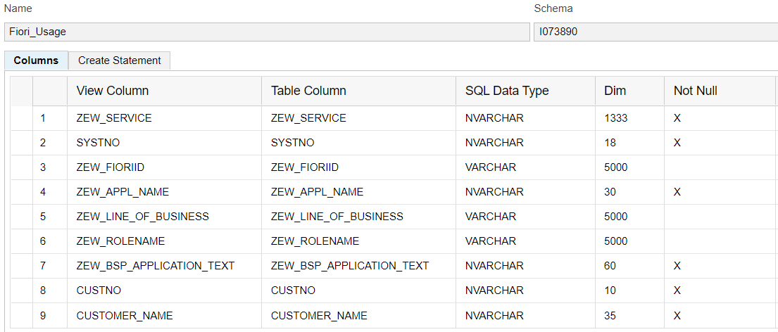
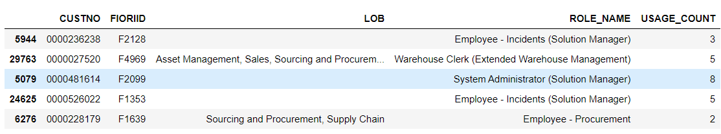
Apps usage count by Customers

Slide 12
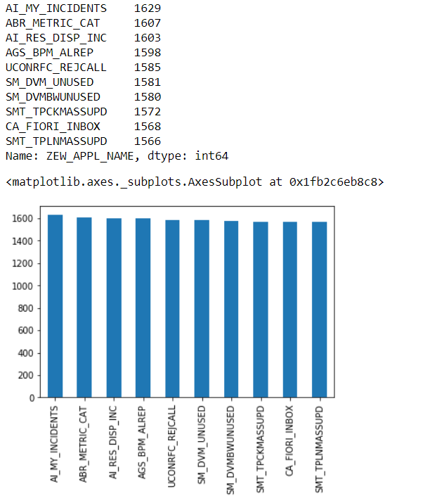
Exploratory Data Analysis Top 10 Used Apps

Slide 13
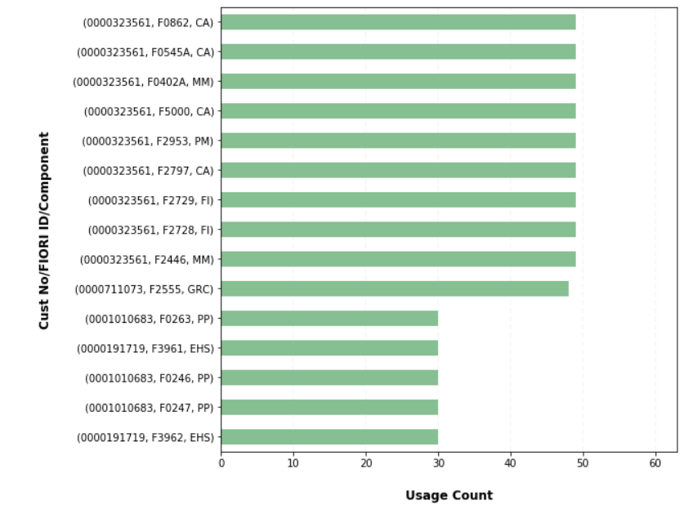
Exploratory Data Analysis Top 15 Customer, Fiori ID, App Component

Slide 14
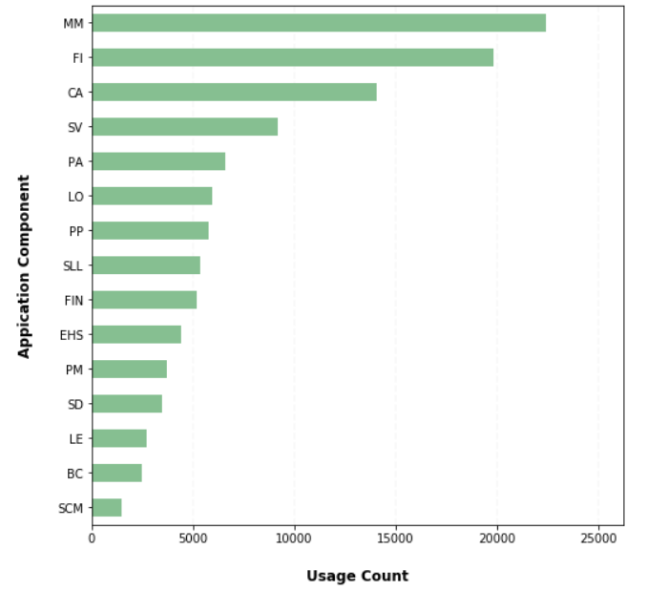
Exploratory Data Analysis Top 15 App Component

Slide 15
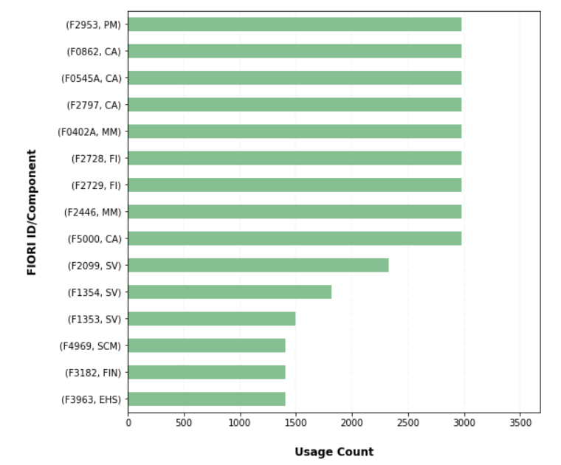
Exploratory Data Analysis Top 15 Fiori Id, App Component

Slide 16
Literature Review
Personalized Product Recommendation in E-Commerce, Sung-Shun and Mei-Ju Liu, IEEe (2004)
Kumar, M., Yadav, D. K., Singh, A., & Kr., V. (2015). A Movie Recommender System: MOVREC. International Journal of Computer Applications
Murali, M. V., Vishnu, T. G., & Victor, N. (2019). A Collaborative Filtering based Recommender System for Suggesting New Trends in Any Domain of Research.
Naveen Kishore, G., Dhiraj, V., Hasane Ahammad Sivaramireddy Gudise, S., Kummara, B., & Akkala, L. R. (2019). Online book recommendation system.
https://realpython.com/build-recommendation-engine-collaborative-filtering/
https://towardsdatascience.com/what-are-product-recommendation-engines-and-the-various-versions-of-them-9dcab4ee26d5
https://itnext.io/what-are-the-top-recommendation-engine-algorithms-used-nowadays-646f588ce639
Algorithms and Methods in Recommender Systems
https://www.snet.tu-berlin.de/fileadmin/fg220/courses/SS11/snet-project/recommender-systems_asanov.pdf

Slide 17
Literature Review
Personalized Product Recommendation in E-Commerce
The purpose of this paper is to analyze customers’ purchasing behaviors based on product features from transaction records and product feature databases. This paper aims to provide personalized recommendations in order to increase customers’ revisiting rate or repurchasing rate
Content-based approach: Through customers’ purchasing histories, the product relevance, such as brand, material, size, color, appearance, price, quality, etc., can be studied to understand customers’ preferences toward particular product features. When a customer browses products online, relevant products can be recommended. Cosine similarity used for this approach
Collaborative filtering approach: This research first analyzes customers’ transaction records for preference analysis. Then Grouping customers with collaborative filtering concepts is conducted in order to find similar groups of target customers so that potential needs or interests of target customers can be recommended which shall improve recommendations that only target right on a customer’s preference. K nearest neighbor is used for this approach.

Slide 18
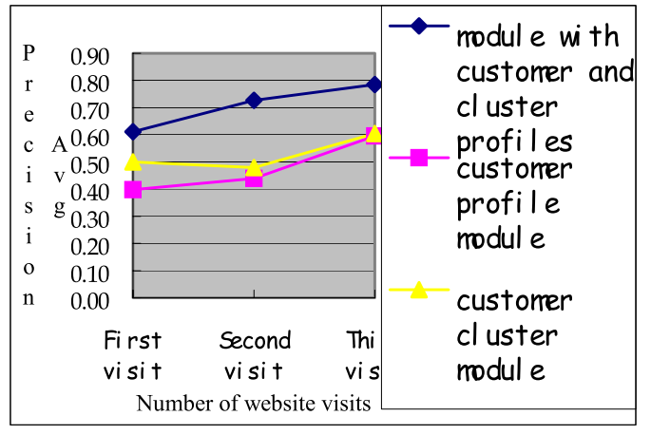
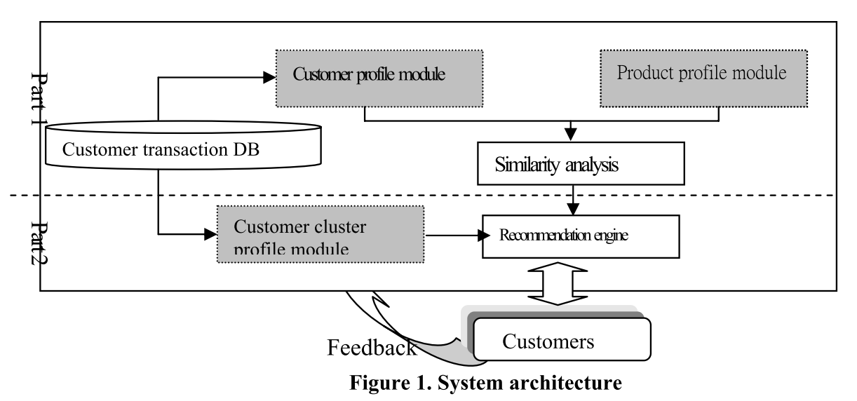
Literature Review

Slide 19
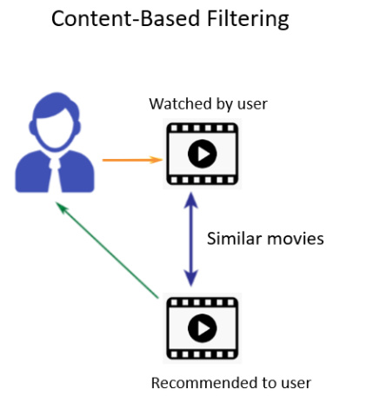


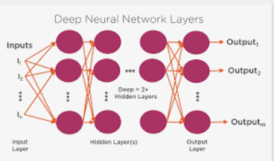


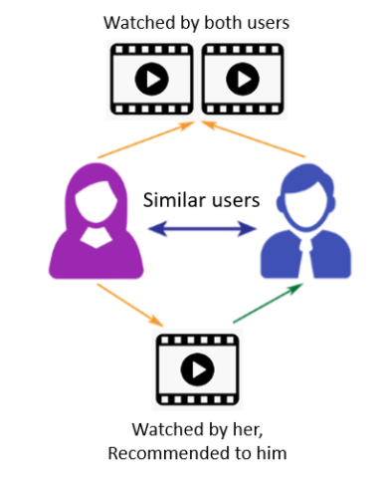
Content Based Recommendation
Apps Used by customer
Similar Apps
Apps recommended to customer
PHD HANA DB Data Access
Count Vectorizer & Cosine Similarities
Residual Learning Model
Final Apps Recommendations to Customer
New HANA View
EDA
Pre-process
Convert text fields to numeric & missing data imputation using K-NN Algorithm
SAP HANA Python Client API
Data Wrangling
SAP HANA Python Client API
Data Pre-processing
Data Wrangling
Data Post-processing & Prediction
SAP HANA WebIDE
Collaborative User based Recommendation
Residual learning model with Keras (Matrix Factorization and Deep Learning)
Apps Used by both customers
Apps Used by Customer 1, Recommend to Customer 2
Python Surprise library
Python

Slide 20
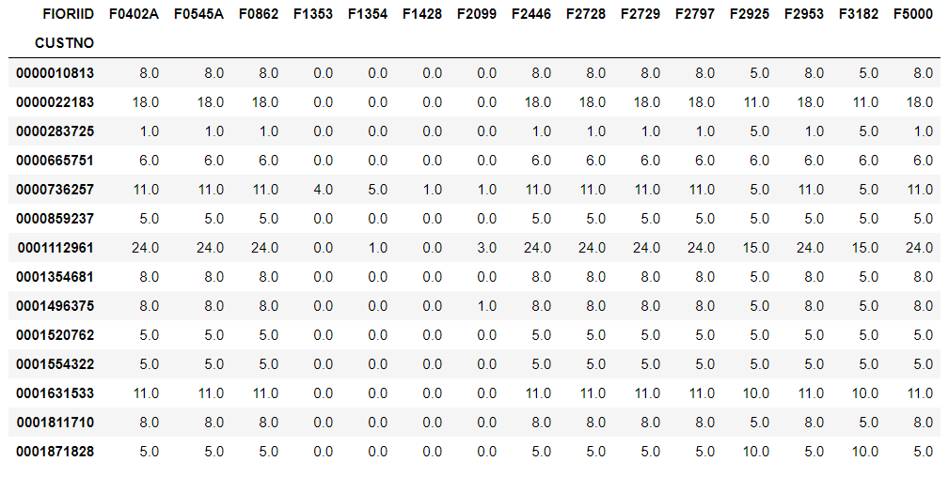
Interaction Matrix of Apps v/s Customers based on Usage

Slide 21
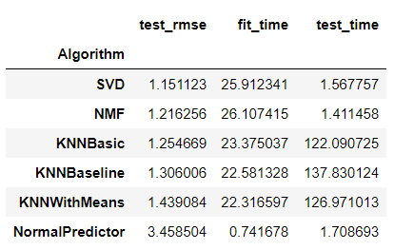
User Based Collaborative Filtering using Surprise Library

Slide 22
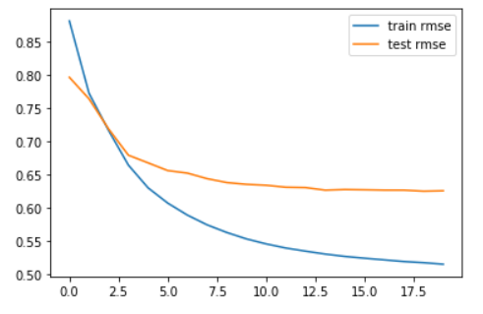
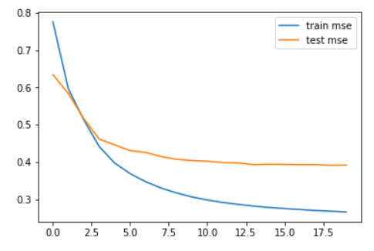
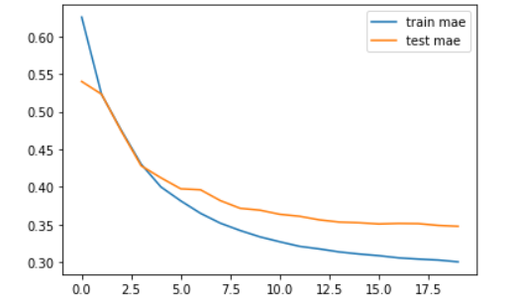
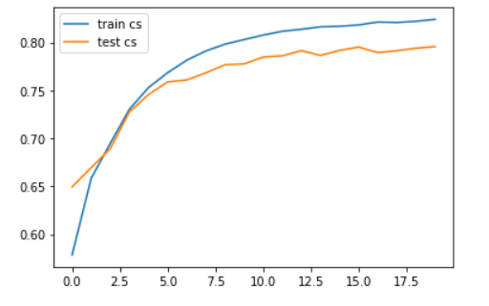
Residual Modelling using Keras (Matrix Factorization and Deep Learning)

Slide 23

Conclusion
Using this Recommender System we would be able to propose personalized recommendation of Trending SAP Fiori Apps to customers, based on their Business and Industry types
This will lead enhanced Customer Satisfaction and in turn better adoption of SAP S/4 HANA system

Slide 24
Next Steps
Release the Solution to SAP Analytics Cloud followed by release to Customers
Extend the Recommendation Engine capabilities to other SAP Solutions like C/4 HANA (CRM Solution), Successfactors (HR Solution) and BW/4 HANA (Business Warehouse Solution)

Slide 25

Thanks

